Slide 1
Divisive Hierarchical Clustering (Top-Down Approach)
Divisive clustering is a hierarchical clustering method that starts with all data points in one single cluster and repeatedly splits them into smaller clusters.
It is the opposite of Agglomerative clustering (which merges).
The most common divisive method is DIANA (Divisive Analysis).
Clustering continues until small groups of similar clusters (each cluster contains a single data
object or k clusters are formed) are obtained

Slide 2
Step 1:
C={all points}
Only one cluster.
Step 2: Choose Cluster to Split
Select the cluster with the largest diameter (most dissimilar points).
Diameter = maximum distance between any two points in the cluster.

Slide 3
Step 3: Find Most Dissimilar Object
For each object i, compute:
Average distance of i to all other objects
Object with largest average distance becomes: Splinter Cluster
Step 4: Move Objects to Splinter Group
For each remaining object j, compute:
Δ(j)=Avg distance to old cluster−Avg distance to splinter cluster
Decision rule:
If Δ(j)>0→ Move to splinter cluster
If Δ(j)≤0→ Keep in original cluster
Repeat until no more objects move.

Slide 4
Step 5: Repeat Splitting
Choose another cluster and repeat steps until:
Desired number of clusters reached
OR
Each point becomes its own cluster

Slide 5
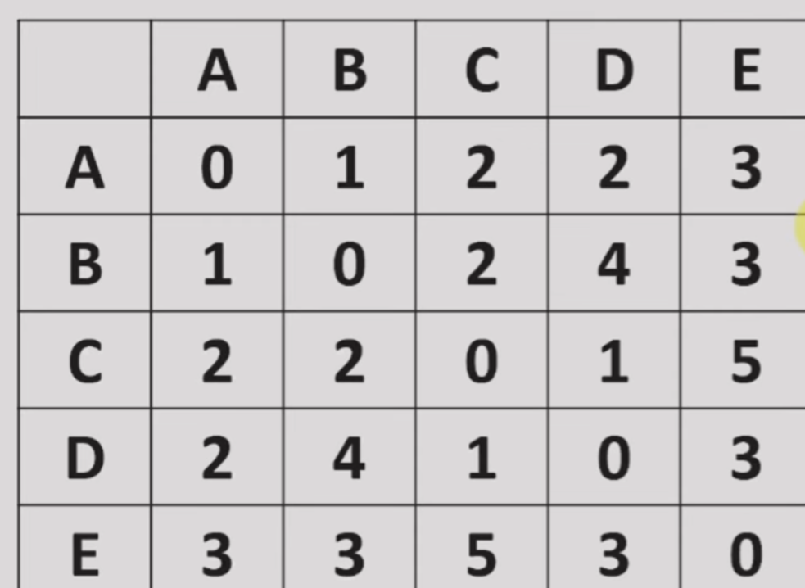

Slide 6
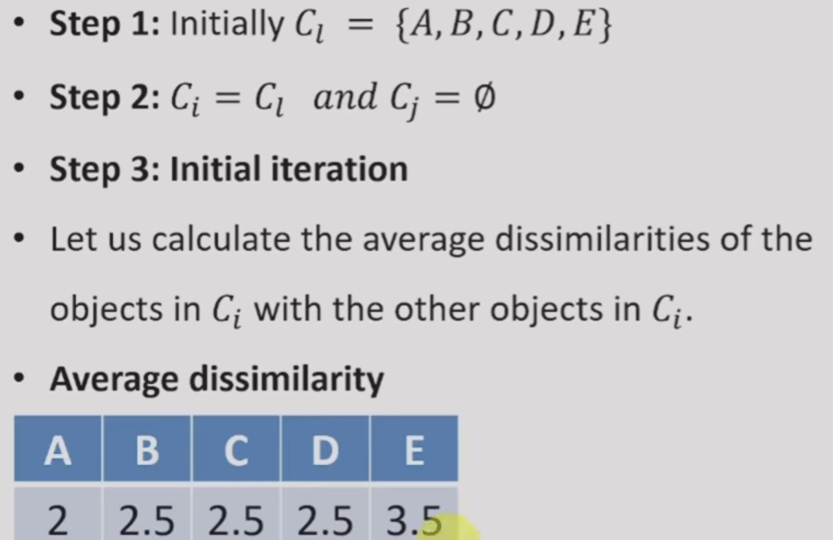

Slide 7


Slide 8
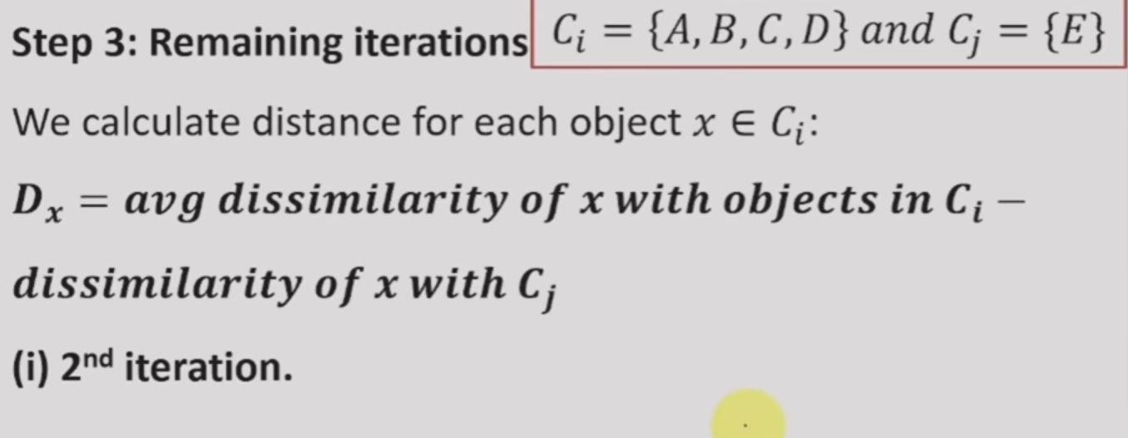

Slide 9
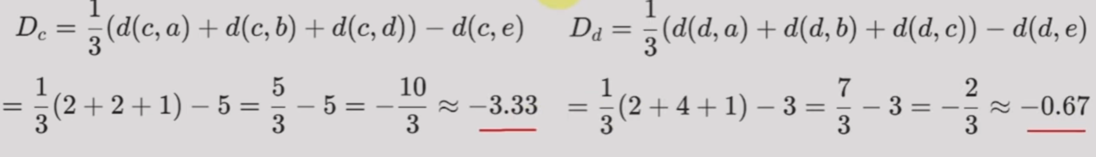

Slide 10
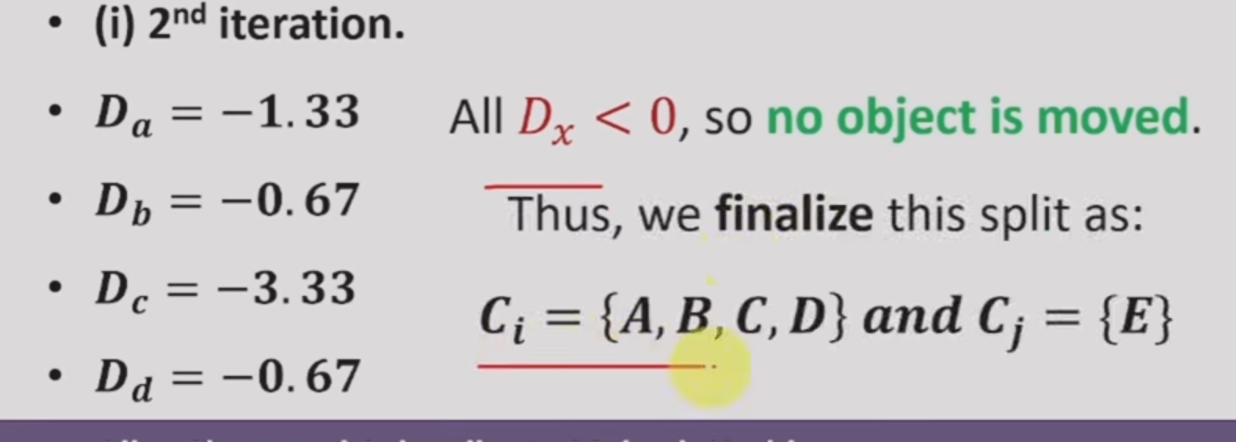

Slide 11
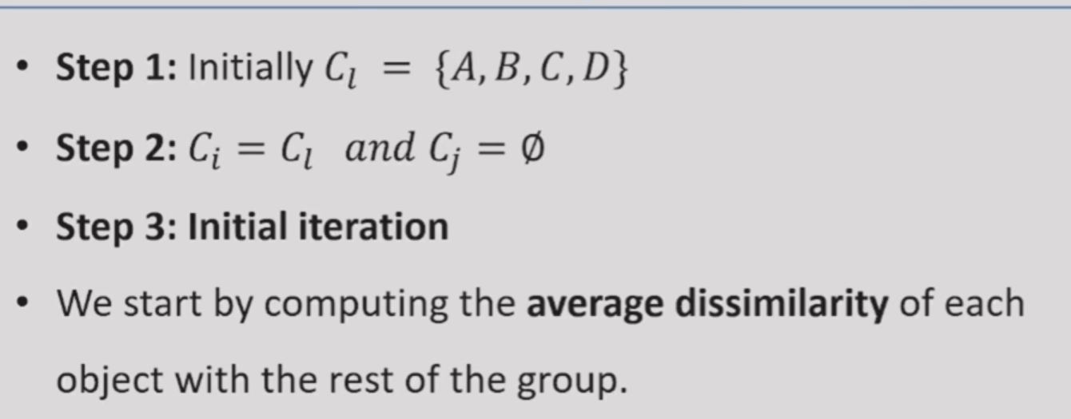

Slide 12
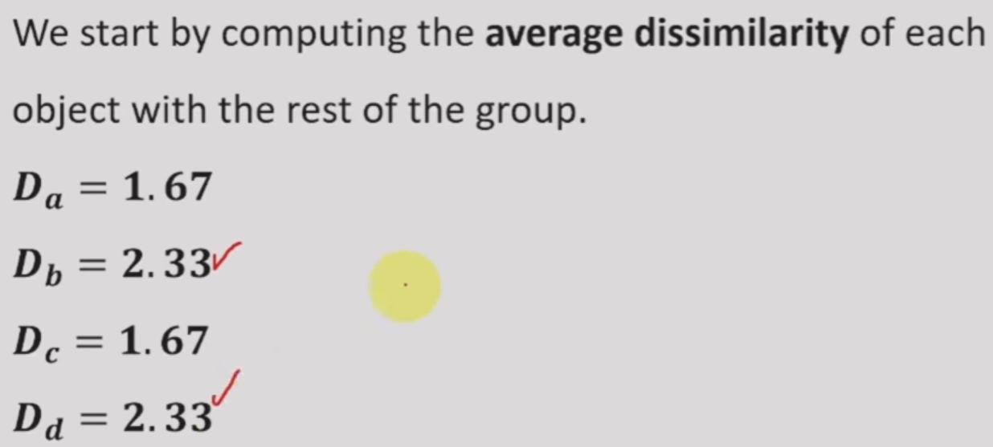

Slide 13
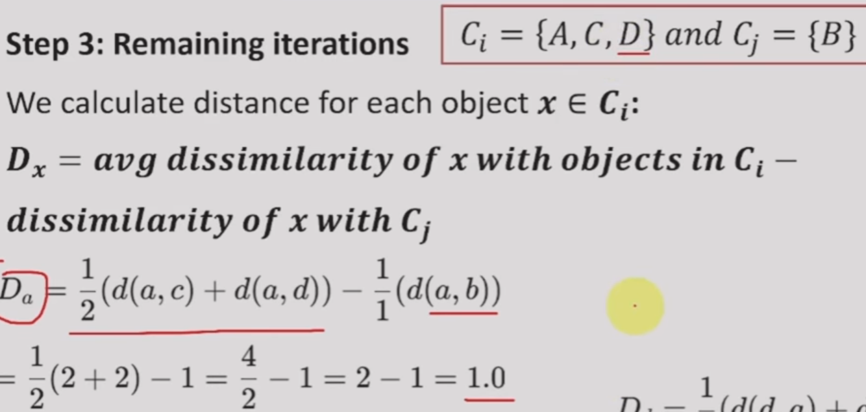

Slide 14
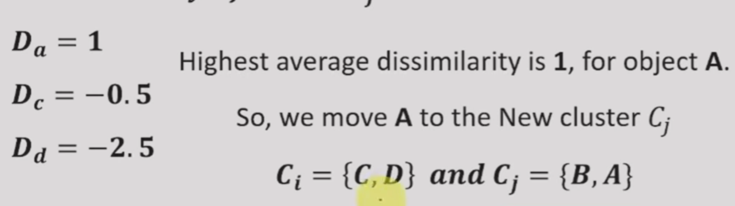

Slide 15
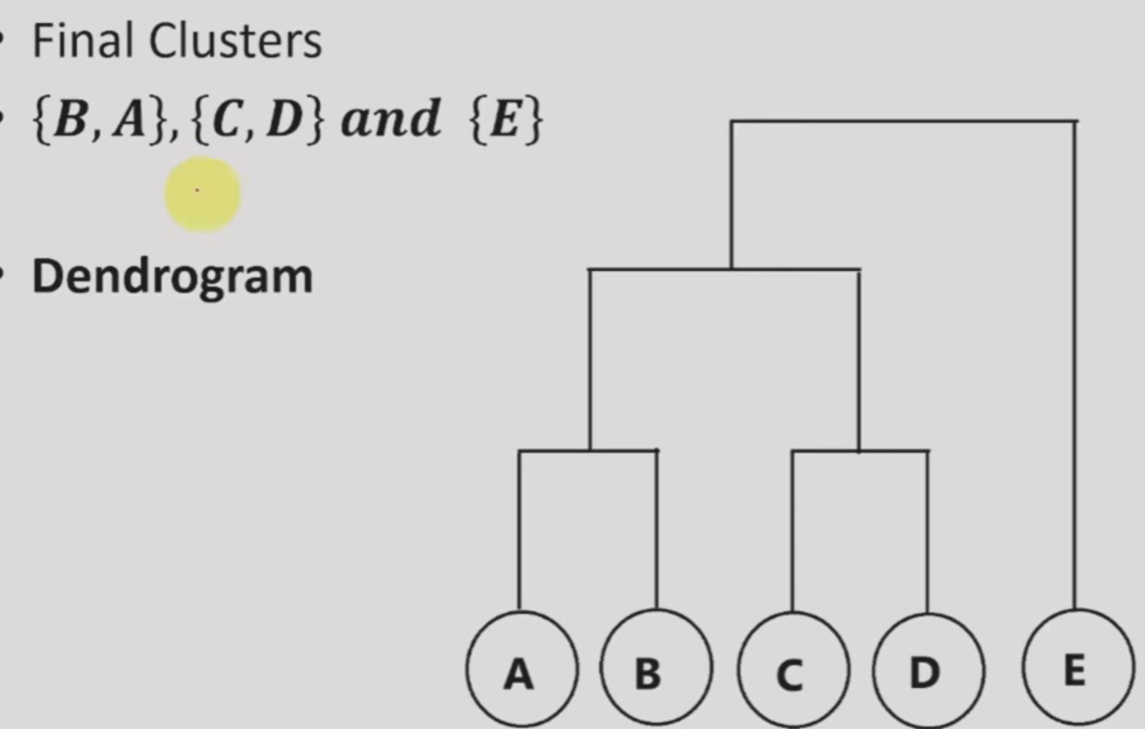

Slide 16
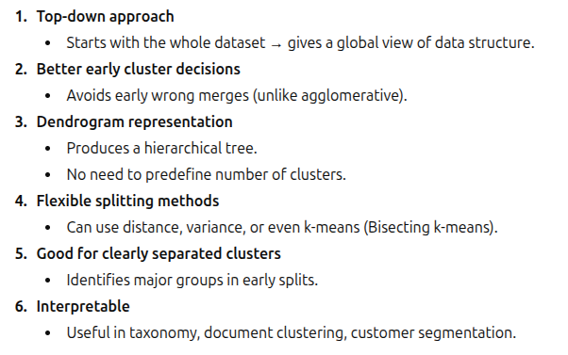
Advantages

Slide 17
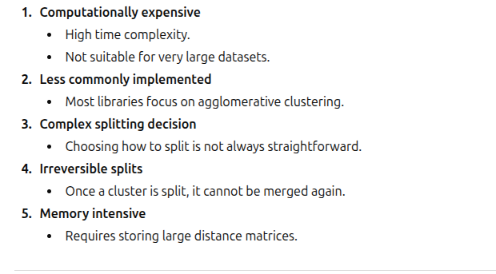
Limitations

